Slide 1

Tail Recursion

Slide 2
Review: Evaluating a Function Application
One simple rule : One evaluates a function application f(e1,...,en)
▶
▶
▶
by evaluating the expressions e1,...,en resulting in the values
v1,...,vn, then
by replacing the application with the body of the function f, in
which
the actual parameters v1,...,vn replace the formal parameters of
f.

Slide 3
Application Rewriting Rule
This can be formalized as a rewriting of the program itself:
def f(x1,...,xn) = B; ... f(v1,...,vn)
→
def f(x1,...,xn) = B; ... [v1/x1,...,vn/xn]B
Here, [v1/x1,...,vn/xn]B means:
The expression B in which all occurrences of xi have been replaced
by vi.
[v1/x1,...,vn/xn] is called a substitution.

Slide 4
Rewriting example:
Consider gcd, the function that computes the greatest common
divisor of two numbers.
Here’s an implementation of gcd using Euclid’s algorithm.
def gcd(a: Int, b: Int): Int =
if (b == 0) a else gcd(b, a % b)

Slide 5
Rewriting example:
gcd(14, 21) is evaluated as follows:
gcd(14, 21)

Slide 6
Rewriting example:
gcd(14, 21) is evaluated as follows:
gcd(14, 21)
→ if (21 == 0) 14 else gcd(21, 14 % 21)

Slide 7
Rewriting example:
gcd(14, 21) is evaluated as follows:
gcd(14, 21)
→ if (21 == 0) 14 else gcd(21, 14 % 21)
→ if (false) 14 else gcd(21, 14 % 21)

Slide 8
Rewriting example:
gcd(14, 21) is evaluated as follows:
gcd(14, 21)
→ if (21 == 0) 14 else gcd(21, 14 % 21)
→ if (false) 14 else gcd(21, 14 % 21)
→ gcd(21, 14 % 21)

Slide 9
Rewriting example:
gcd(14, 21) is evaluated as follows:
gcd(14, 21)
→ if (21 == 0) 14 else gcd(21, 14 % 21)
→ if (false) 14 else gcd(21, 14 % 21)
→ gcd(21, 14 % 21)
→ gcd(21, 14)

Slide 10
Rewriting example:
gcd(14, 21) is evaluated as follows:
gcd(14, 21)
→ if (21 == 0) 14 else gcd(21, 14 % 21)
→ if (false) 14 else gcd(21, 14 % 21)
→ gcd(21, 14 % 21)
→ gcd(21, 14)
→ if (14 == 0) 21 else gcd(14, 21 % 14)

Slide 11
Rewriting example:
gcd(14, 21) is evaluated as follows:
gcd(14, 21)
→ if (21 == 0) 14 else gcd(21, 14 % 21)
→ if (false) 14 else gcd(21, 14 % 21)
→ gcd(21, 14 % 21)
→ gcd(21, 14)
→ if (14 == 0) 21 else gcd(14, 21 % 14)
→ gcd(14, 7)

Slide 12
Rewriting example:
gcd(14, 21) is evaluated as follows:
gcd(14, 21)
→ if (21 == 0) 14 else gcd(21, 14 % 21)
→ if (false) 14 else gcd(21, 14 % 21)
→ gcd(21, 14 % 21)
→ gcd(21, 14)
→ if (14 == 0) 21 else gcd(14, 21 % 14)
→ gcd(14, 7)
→ gcd(7, 0)

Slide 13
Rewriting example:
gcd(14, 21) is evaluated as follows:
gcd(14, 21)
→ if (21 == 0) 14 else gcd(21, 14 % 21)
→ if (false) 14 else gcd(21, 14 % 21)
→ gcd(21, 14 % 21)
→ gcd(21, 14)
→ if (14 == 0) 21 else gcd(14, 21 % 14)
→ gcd(14, 7)
→ gcd(7, 0)
→ if (0 == 0) 7 else gcd(0, 7 % 0)

Slide 14
Rewriting example:
gcd(14, 21) is evaluated as follows:
gcd(14, 21)
→ if (21 == 0) 14 else gcd(21, 14 % 21)
→ if (false) 14 else gcd(21, 14 % 21)
→ gcd(21, 14 % 21)
→ gcd(21, 14)
→ if (14 == 0) 21 else gcd(14, 21 % 14)
→ gcd(14, 7)
→ gcd(7, 0)
→ if (0 == 0) 7 else gcd(0, 7 % 0)
→ 7

Slide 15
Another rewriting example:
Consider factorial:
def factorial(n: Int): Int =
if (n == 0) 1 else n * factorial(n - 1)
factorial(4)

Slide 16
Another rewriting example:
Consider factorial:
def factorial(n: Int): Int =
if (n == 0) 1 else n * factorial(n - 1)
factorial(4)
→ if (4 == 0) 1 else 4 * factorial(4 - 1)

Slide 17
Another rewriting example:
Consider factorial:
def factorial(n: Int): Int =
if (n == 0) 1 else n * factorial(n - 1)
factorial(4)
→ if (4 == 0) 1 else 4 * factorial(4 - 1)
→ 4 * factorial(3)

Slide 18
Another rewriting example:
Consider factorial:
def factorial(n: Int): Int =
if (n == 0) 1 else n * factorial(n - 1)
factorial(4)
→ if (4 == 0) 1 else 4 * factorial(4 - 1)
→ 4 * factorial(3)
→ 4 * (3 * factorial(2))

Slide 19
Another rewriting example:
Consider factorial:
def factorial(n: Int): Int =
if (n == 0) 1 else n * factorial(n - 1)
factorial(4)
→ if (4 == 0) 1 else 4 * factorial(4 - 1)
→ 4 * factorial(3)
→ 4 * (3 * factorial(2))
→ 4 * (3 * (2 * factorial(1)))

Slide 20
Another rewriting example:
Consider factorial:
def factorial(n: Int): Int =
if (n == 0) 1 else n * factorial(n - 1)
factorial(4)
→ if (4 == 0) 1 else 4 * factorial(4 - 1)
→ 4 * factorial(3)
→ 4 * (3 * factorial(2))
→ 4 * (3 * (2 * factorial(1)))
→ 4 * (3 * (2 * (1 * factorial(0)))

Slide 21
Another rewriting example:
Consider factorial:
def factorial(n: Int): Int =
if (n == 0) 1 else n * factorial(n - 1)
factorial(4)
→ if (4 == 0) 1 else 4 * factorial(4 - 1)
→ 4 * factorial(3)
→ 4 * (3 * factorial(2))
→ 4 * (3 * (2 * factorial(1)))
→ 4 * (3 * (2 * (1 * factorial(0)))
→ 4 * (3 * (2 * (1 * 1)))

Slide 22
Another rewriting example:
Consider factorial:
def factorial(n: Int): Int =
if (n == 0) 1 else n * factorial(n - 1)
factorial(4)
→ if (4 == 0) 1 else 4 * factorial(4 - 1)
→ 4 * factorial(3)
→ 4 * (3 * factorial(2))
→ 4 * (3 * (2 * factorial(1)))
→ 4 * (3 * (2 * (1 * factorial(0)))
→ 4 * (3 * (2 * (1 * 1)))
→ 120

Slide 23
Tail Recursion
Implementation Consideration: If a function calls itself as its last
action, the function’s stack frame can be reused. This is called tail
recursion.
⇒ Tail recursive functions are iterative processes.
In general, if the last action of a function consists of calling a
function (which may be the same), one stack frame would be
suﬃcient for both functions. Such calls are called tail-calls.

Slide 24
Tail Recursion in Scala
In Scala, only directly recursive calls to the current function are
optimized.
One can require that a function is tail-recursive using a @tailrec
annotation:
@tailrec
def gcd(a: Int, b: Int): Int = ...
If the annotation is given, and the implementation of gcd were not
tail recursive, an error would be issued.

Slide 25
Exercise: Tail recursion
Design a tail recursive version of factorial.

Slide 26
Stack Frame
https://prasanthmadhavan.wordpress.com/2010/09/15/recursion/
http://eli.thegreenplace.net/2011/02/04/where-the-top-of-the-stack-is-on-x86/

Slide 27
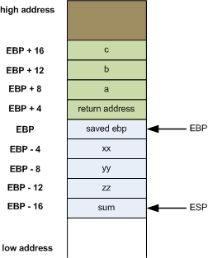
Stack Frame in x86

Slide 28
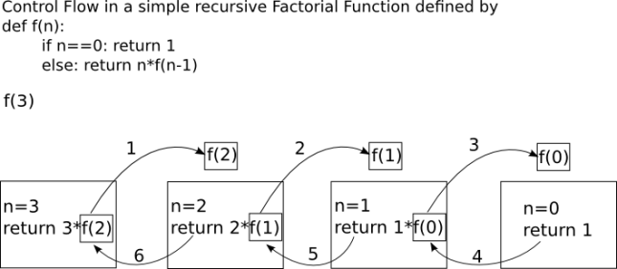
Factorial Function – recursive (1)

Slide 29
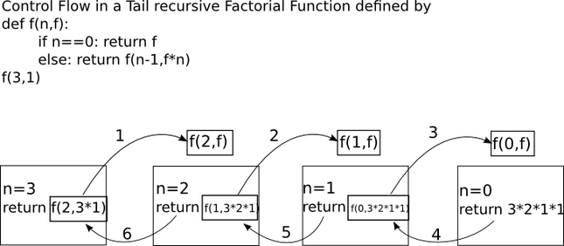
Factorial Function – recursive (2)

Slide 30
Tail Recursion
This is another kind of recursion that is employed for recursion
Tail Call Elimination
By using this elimination method,
we can get the power of recursion without the overhead of extra stack space
What a Tail Call Elimination procedure does
it changes the recursive step to purely iterative and executed
This process of tail call elimination is done by the compiler

